Slide 1
Deduction
Mirko Farina
Assistant Professor
Innopolis University
* I do not claim authorship for all texts and pictures in the presentation.

Slide 2
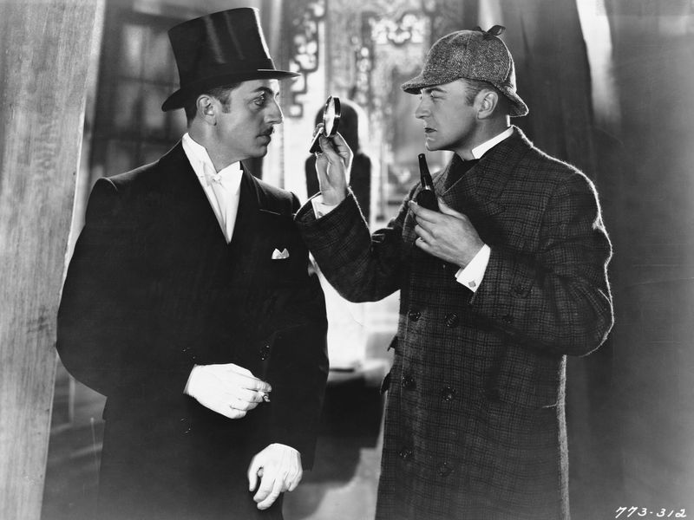
‘The Science of Deduction and Analysis is one which can only be acquired by long and patient study, nor is life long enough to allow any mortal to attain the highest possible perfection in it’.
- From an article by Sherlock Holmes, in A Study in Scarlet by Sir Arthur Conan Doyle
2
Notes:
2

Slide 3
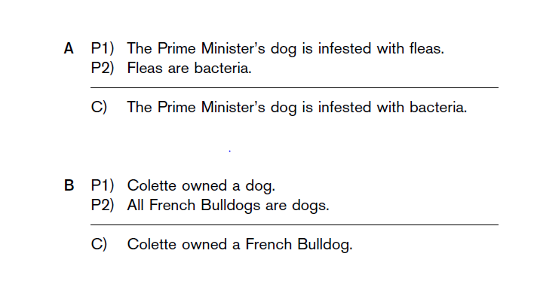
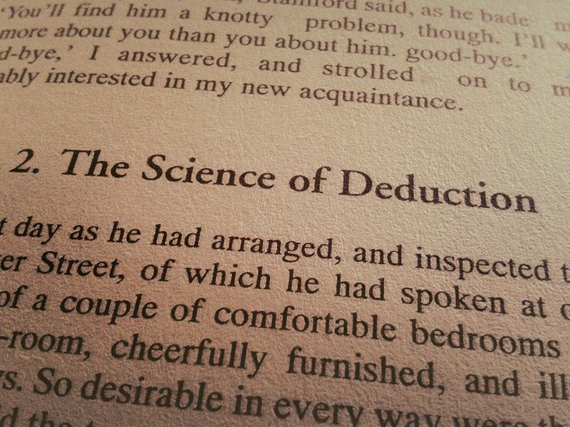
Deductive validity
3
Notes:
3

Slide 4
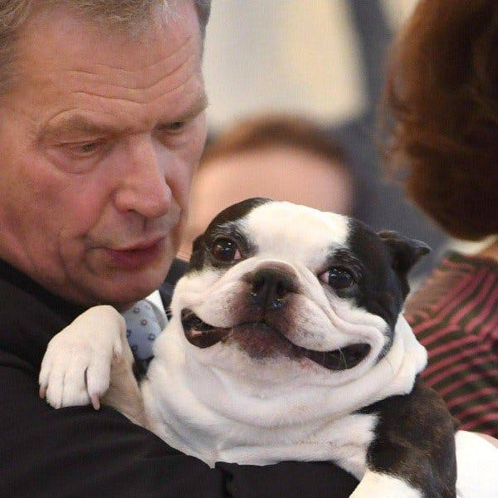
A.
P1, no idea what dog, if any, has been referred to.
In addition P2 is false – fleas are insects, not bacteria.
4
Notes:
4

Slide 5
But scrutinise these arguments carefully.
Something is right about A, something is wrong about B
A is valid, and that B is invalid.

Slide 6
Puzzling but true → the premises of B are true. -→ the conclusion of B is also true
But!!
A person given only the premises of the argument, and lacking
any further information about Colette, would be in no position to infer that Colette had a French Bulldog
6
Notes:
6

Slide 7
validity is about the connection between the premises and conclusion of an argument, not their truth-values considered individually.
7
Notes:
7

Slide 8

TWO DEFINITIONS OF VALIDITY
To say that an argument is valid is to say that given the premises the conclusion must follow
8
Notes:
8

Slide 9

How to test for validity
ignore the actual truth-values of the premises and the actual truth value of the conclusion
9
Notes:
9

Slide 10
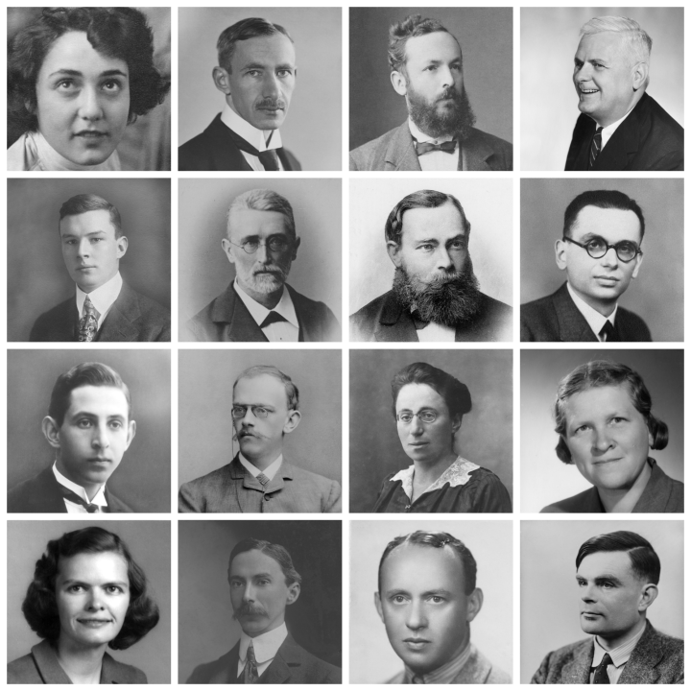
validity is studied by logicians
So, logicians are concerned only with relations between propositions, not with their truth-values
10
Notes:
10

Slide 11
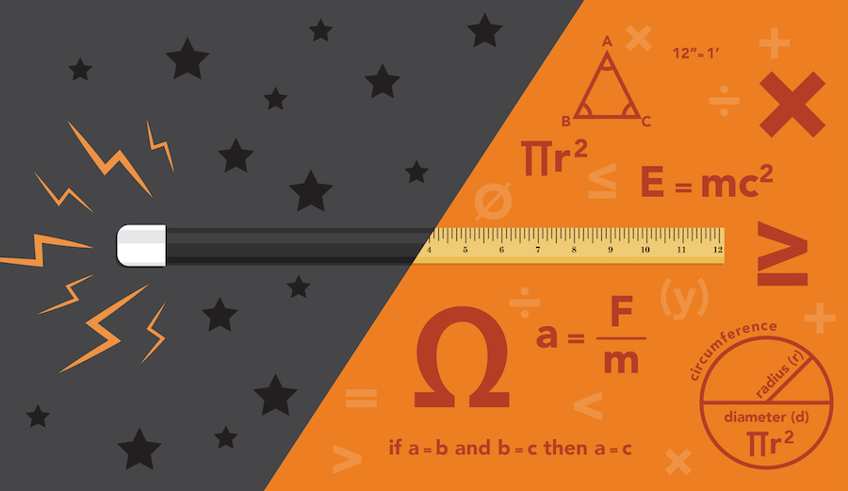
Here follow more valid arguments (fictional examples!)
Important to understand that validity is not relate to actual truthfulness
11
Notes:
11

Slide 12
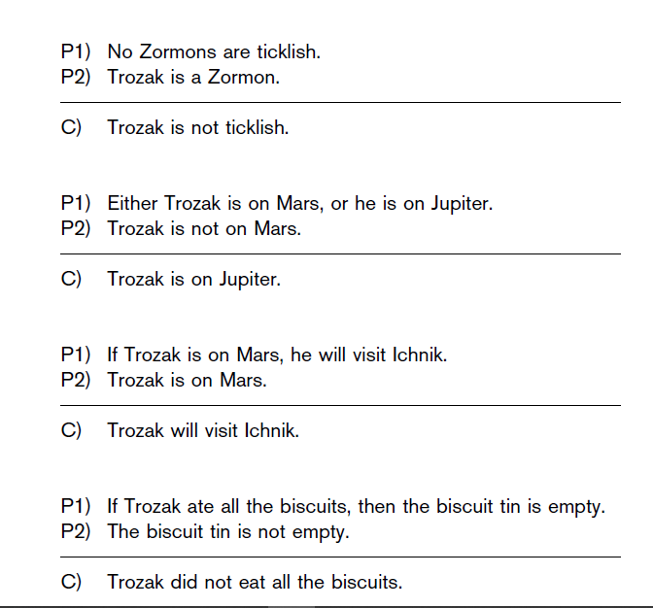
12
Notes:
12

Slide 13

OCCASION to distinguish between arguments and conditionals
Conditionals = ‘if–then’ form of declarative sentence (statements)
If it is raining, then the barometric pressure is low.
13
Notes:
13

Slide 14

Other example of the same conditional
It is raining only if the barometric pressure is low.
Either the barometric pressure is low, or it is not raining.
It is not raining unless the barometric pressure is low.
If the barometric pressure is not low, then it is not raining.
It is not raining if the barometric pressure is not low.
The barometric pressure is low if it is raining.
There cannot be rain without low barometric pressure.
14
Notes:
14

Slide 15

if a is true then b is true also.
It is raining −> The barometric pressure is low.
Antecedent, and Consequent!
15
Notes:
15

Slide 16

Arguments can be made of conditional statements. For example:
P1) If Labour does not change its platform, it will not attract new supporters.
P2) If Labour does not attract new supporters, it will lose the next election.
------------
C) If Labour does not change its platform, then it will lose the next election.
16
Notes:
16

Slide 17
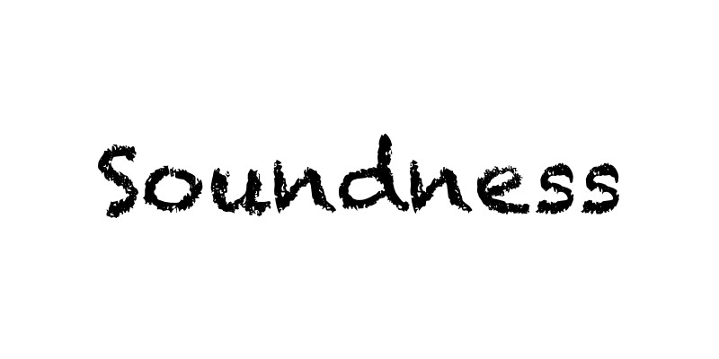
Soundness
Knowing that the argument is valid is not enough to show you that the conclusion is true.
You need to determine its truth- value
17
Notes:
17

Slide 18

To say that an argument is deductively sound is to say:
The argument is valid, and all its premises are (actually) true.
18
Notes:
18

Slide 19
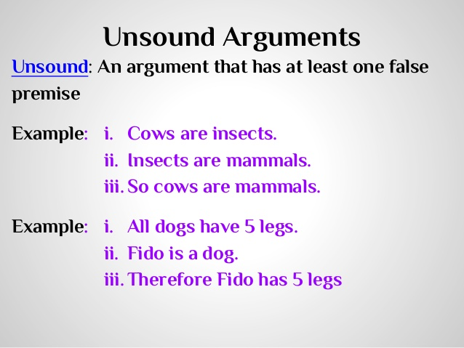
An argument that has one or more false premises, or is invalid, or both – is deductively unsound.
19
Notes:
19

Slide 20
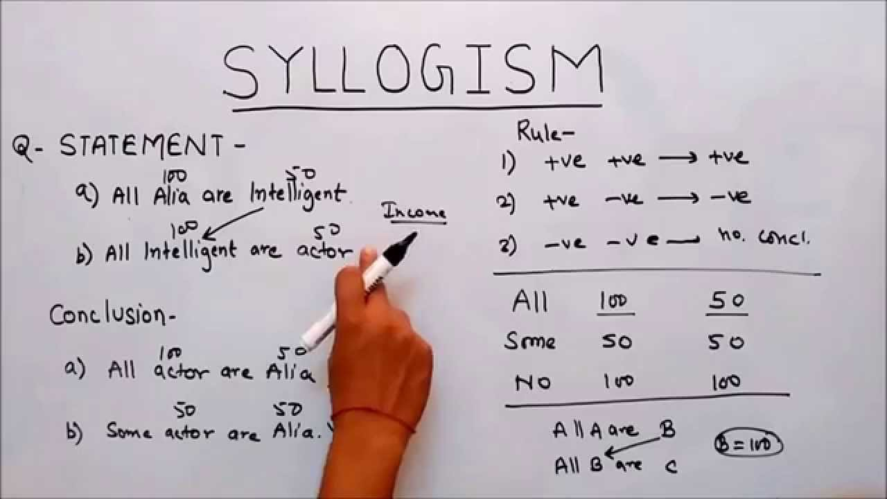
Combination of these sentences give us Syllogisms
Deductive argument that contains exactly two premises.

Slide 21
Disjunctive syllogisms
A.
Either Mary is with her mother, or she is with a doctor.
Mary is not with a doctor.
Therefore, Mary is with her mother.
valid

Slide 22

B.
Either Mary is with her mother, or she is with a doctor.
Mary is with a doctor.
Therefore, Mary is not with her mother.

Slide 23
Seems valid but its not!
It is entirely possible that Mary is with two people or that Mary’s mother is a doctor. This third option is a counterexample to B.

Slide 24
A disjunctive syllogism is valid iff has one of these two forms.
P or Q
Not P
Therefore, Q
P or Q
Not Q
Therefore, P

Slide 25
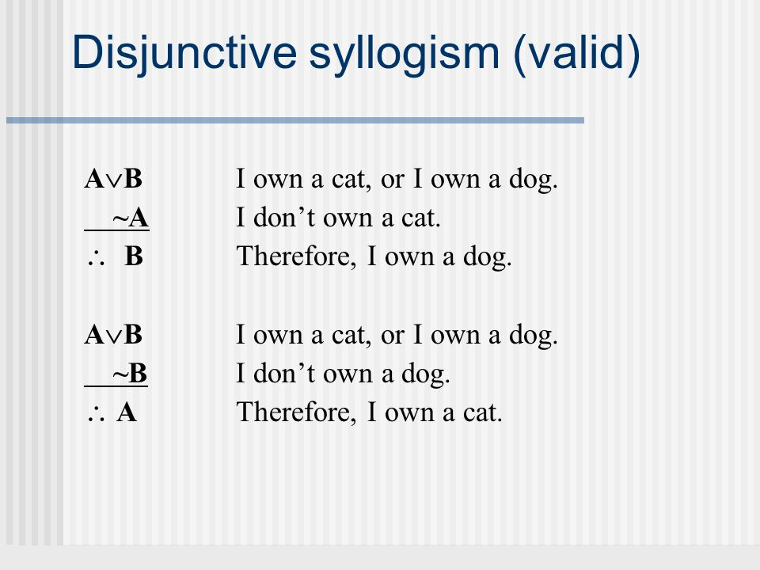

Slide 26
It is invalid if it has one of these.
P or Q
P
Therefore, not Q
P or Q
Q
Therefore, not P

Slide 27
NEXT, other hypothetical syllogisms
Modus ponens, (T)
Modus tollens, (T)
The fallacy of denying the antecedent (F) The fallacy of affirming the consequent (F)
27
Notes:
27

Slide 28
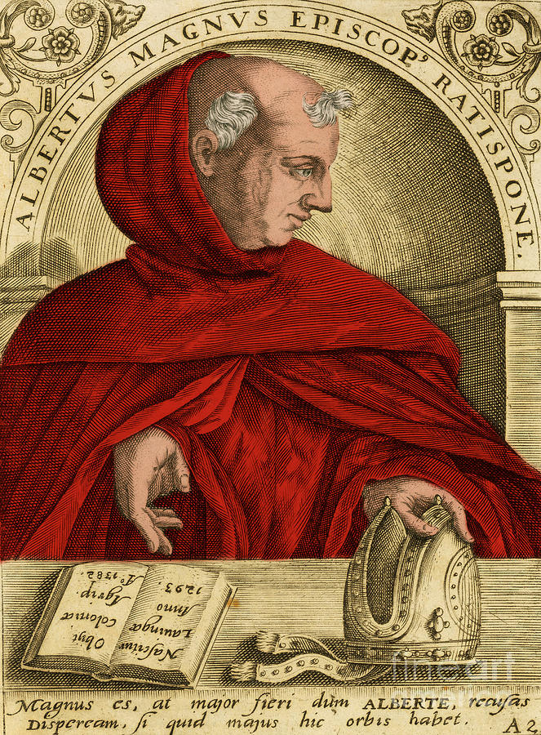
Modus ponens
If P, then Q
P
Therefore, Q
28
Notes:
28

Slide 29

If you have a current password, then you can log on to the network“ (P1)
"You have a current password“ (P2) -------Therefore:
"You can log on to the network“ (C)

Slide 30
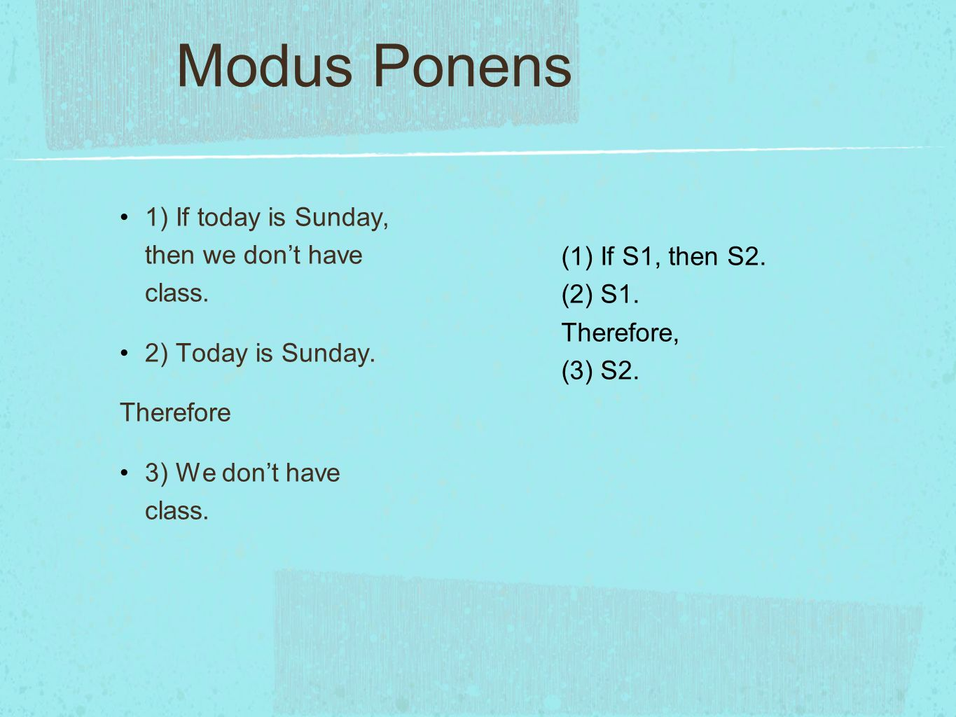

Slide 31
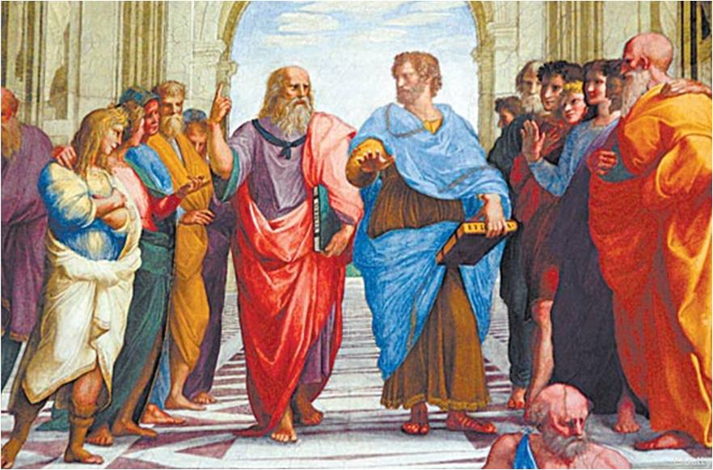
Modus tollens
If P, then Q
Not Q
Therefore, not P
31
Notes:
31

Slide 32

If Sam was born in Canada, then he is Canadian.
Sam is not Canadian.
Therefore, Sam was not born in Canada.

Slide 33
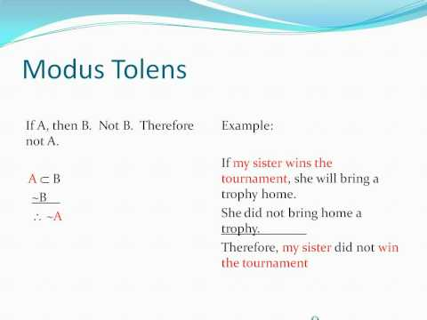

Slide 34
modus ponens or modus tollens are always valid.
But not all syllogisms are valid …
34
Notes:
34

Slide 35
An argument commits the fallacy of denying the antecedent and is always invalid if
If P, then Q
Not P
Therefore not Q
35
Notes:
35

Slide 36

If Mary is visiting [P], then there are eggs and toast for dinner [Q].
Mary is not visiting [Not P].
Therefore, there are not eggs and toast for dinner [Not Q].
36
Notes:
36

Slide 37
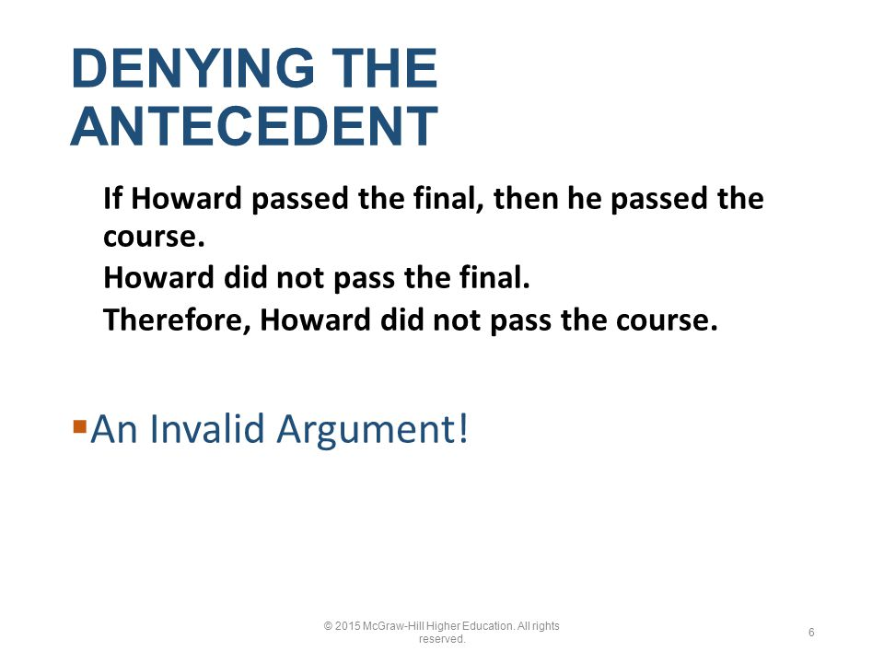

Slide 38
An argument commits the similar fallacy of affirming the consequent and is likewise invalid if
If P, then Q
Q
Therefore, P
38
Notes:
38

Slide 39
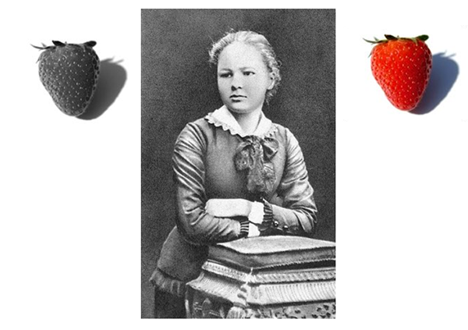
If Mary is visiting [P], then there are eggs and toast for dinner [Q].
There are eggs and toast for dinner [Q].
Therefore, Mary is visiting [P].
39
Notes:
39

Slide 40
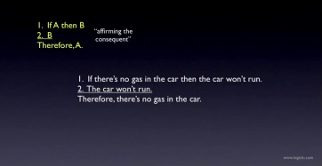

Slide 41


